Slide 1


Regulatory Capital Requirements –Overview
Why economic capital is not enough…
March 2025

Slide 2
Agenda
Section 1 The role and the importance of the Regulator 3
Section 2 Regulatory Capital vs Economic Capital 6
Section 3 How to measure the regulatory capital for Banks 11
Section 4 Derivation of the Formula for RWAs – corporate loans example 19
Section 5 Concluding remarks 24
Section 6 Q&A 25

Slide 3
Section 1
The role and the importance of the Regulator

Slide 4
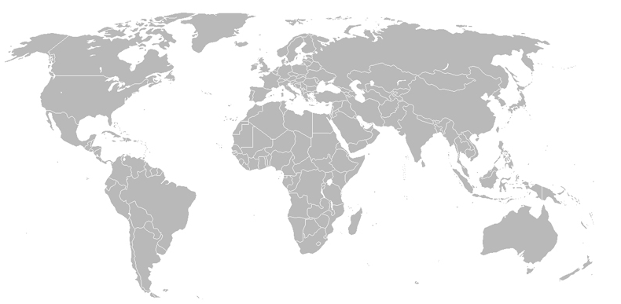
Financial regulation – The Regulator
Facts:
Financial regulation is a form of regulation or supervision, which subjects financial institutions to certain requirements, restrictions and guidelines, aiming to maintain the integrity of the financial system. This may be handled by either a government or non-government organization.
See map below for a few examples of regional regulation bodies.
Goals of the financial regulation:
market confidence – to maintain confidence in the financial system.
financial stability – contributing to the protection and enhancement of stability of the financial system.
consumer protection – securing the appropriate degree of protection for consumers.
reduction of financial crime – reducing the extent to which it is possible for a regulated business to be used for a purpose connected with financial crime.
regulating foreign participation in the financial markets.
Prudential
Regulation Authority
Financial Services Agency
FINMA
Basel Committee on Bank Supervision (BCBS)
China Banking Regulatory Commission
Federal Reserve System (FED)
Securities and Exchange Commission (SEC)
…
Monetary Authority of Singapore

Slide 5
History
“There are strong reasons for believing that banks left to their own devices would maintain less capital—not more—than would be prudent. The fact is, banks do benefit from implicit and explicit government safety nets. Investing in a bank is perceived as a safe bet. Without proper capital regulation, banks can operate in the marketplace with little or no capital. And governments and deposit insurers end up holding the bag, bearing much of the risk and cost of failure. History shows this problem is very real … as we saw with the U.S. banking and S & L crisis in the late 1980s and 1990s. The final bill for inadequate capital regulation can be very heavy. In short, regulators can't leave capital decisions totally to the banks. We wouldn't be doing our jobs or serving the public interest if we did."*
*Source: Remarks By Sheila Bair Chairman, U.S. Federal Deposit Insurance Corporation; 2007 Risk Management and Allocation Conference, Paris, France, June 25, 2007, http://www.fdic.gov/news/news/speeches/archives/2007/chairman/spjun2507.html

Slide 6
Section 2
Regulatory Capital vs Economic Capital

Slide 7
Economic capital (EC)
Represents the amount of capital that the entity needs to have in place (maintain reasonable balance sheet in terms of fair value) to stay solvent (knowing time horizon and confidence level);
Can be understood as a capital buffer for bank with capacity to absorb expected and some unexpected losses (knowing time horizon and confidence level; i.e. calculated as Value At Risk (VAR));
Can be calculated both at single risk level or aggregated one (can reflect the risk of the current portfolio / exposure / project and assures that decisions are taken based on risk-adjusted basis);
Economic capital can be seen as a tool developed and implemented by individual entity for internal risk management purpose;
It allows banks to assess profitability of risk-taking activities, efficiently allocate capital across the banks divisions and cover the economic effects of investments decisions.

Slide 8
Regulatory Capital (RC)
Is the mandatory minimal amount of capital to be kept by banks ( e.g. Basel II’s Pillar 1 minimum capital requirement);
Usually established at aggregated risk level (e.g Basel II is minimum capital requirement for whole entity as ∑ of capital for credit, operational and market risk) so cannot be directly assigned to portfolio, exposure or project level to facilitate risk-based decisions;
RC can significantly deviate from the actual / desirable capital levels (determined by sophisticated risk-based capital methodology). It might be due to company specific circumstances or Point-in-Time risk calculation.
The purpose of RC is to keep bank up and running even in catastrophic situation;
In general RC>>EC but in some circumstances relying solely on regulatory capital may lead to significantly undercapitalized or overcapitalized companies;

Slide 9
Why Economic capital is not enough?
Catastrophic Loss
Ultra low frequency
Ultra high severity
Unexpected Loss
Low frequency
High severity
Expected Loss:
High frequency
Low severity
Regulatory Capital
Economic Capital

Slide 10
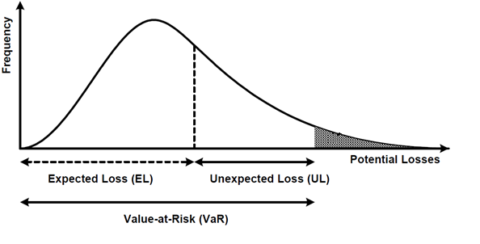
Loss: expected / unexpected / catastrophic
Expected Loss (EL):
the cost of doing business, covered within the pricing (charged to the client) and provisions calculations
Calculation:
EL[% of Exposure] = PD * LGD
Unexpected Loss (UL):
losses above expected levels, time and severity is impossible to know in advance, covered by sufficient company's capital
Calculation:
RWAs / Risk Scenarios / VaR
Catastrophic Loss (CL):
extremely rare events, sometimes even never observed, can be thought as "nuclear", at least partially covered by company's capital
Calculation:
Stress Testing / TVaR
(Tail VaR= VaR + expected average loss in excess of VaR)
EL
UL
CL
Value-at-Risk(VaR) or EL + scenario
Tail Value-at-Risk(VaR) or EL+UL+ Stress Tests

Slide 11
Section 3
How to measure the regulatory capital for banks?

Slide 12
The Sources of Risk for Banks – Primary Risks
Financial
/ Primary Risks
Liquidity Risk
Credit Risk
Commodity Prices
Equity Prices
Exchange Rates
Interest Rates

Slide 13
New regulatory capital requirements
Facts:
One of the most dramatic changes to the banking industry since the last financial crisis is the rollout of new capital requirements for banks.
Today, banks are required to hold higher amounts of capital, dictated by a "complex" formula.
This capital protects the bank from (unexpected) losses and ultimately protects taxpayers from potential expensive bailouts.
How to determine that capital level?
The simplest approach would be to require all banks to maintain a maximum leverage ratio, something like the assets-to-shareholder equity ratio.
This concept would be
simple
everyone could understand it, and
there would be no question which banks were overly leveraged.

Slide 14
First idea – Leverage ratio
Bank A
Bank B
Assets
Liabilities
Assets
Liabilities
Equity
Equity
Leverage ratio = Equity / Assets
Leverage ratio Bank A = Leverage ratio Bank B
Asset composition:
50% Treasuries, 25% highly rated loans, 15% in branches and buildings, and 10% in cash
→ conservative assets structure
Asset composition:
50% in subprime loans, 29% in risky derivatives, 20% in branches, and 1% in cash.
→ risky assets structure
Using the assets-to-shareholder equity approach is not correctly reflecting the assets compositions and the risks involved → the leverage ratio does not describe the full picture
→ main idea: re-scale the bank's assets by considering the underlying risk (see next page)

Slide 15
Second idea – risk based approach
Bank A
Bank B
Risk Weights
Assets
Risk Weights
Assets
Liabilities
Liabilities
RWAs
RWAs
Equity
Equity
Capital Adequacy Ratio (CAR) := Equity / RWAs
CAR Bank A >> CAR Bank B
where RWAs stands for Risk Weights Assets.
Regulators require Banks to hold a minimum CAR.
How to derive adequate risk weights? Which are the risk factors that should determine the risk weights?

Slide 16

Risk metrics and the "complex" formula
From the previous page, risk weights seem to be the key figure in order to correctly scale the Bank's asset side by considering its exposure to risk.
From an intuitive point of view, at least the following risk metrics should influence the risk weights:
Probability of Default
Loss Given Default
Asset Correlation
Maturity
PD
LGD
R
M
The Basel Committee has derived following mathematical formula for the risk weights:
where:
N(x) is the cumulative distribution function of the normal distribution
G(x) is the inverse of N
R is a certain correlation factor that depends on PD.

Slide 17
The Sources of Risk for Banks – Secondary Risks
Non-Financial
/ Secondary Risks
Accounting
Taxes
Legal
Regulations
Settlement
Model
Operational

Slide 18
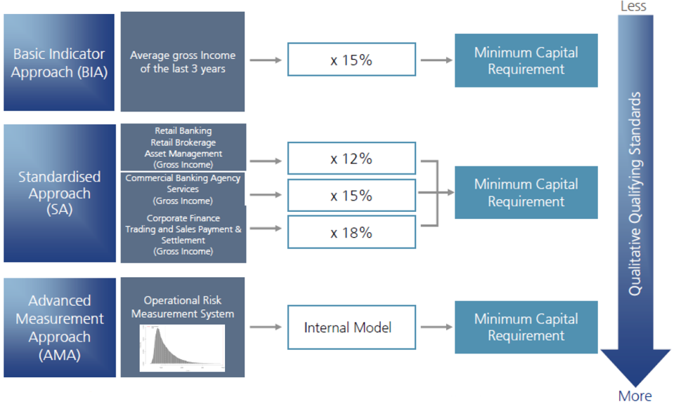
Three levels of shopistication – Operational Risk Example

Slide 19
Section 4 (optional)
Derivation of the Formula for RWAs – corporate loans example

Slide 20
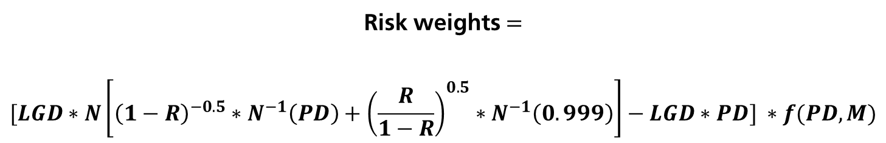
Economic Foundations of the Risk Weight Formula
Risk weights $=$
$$[LGD∗N\left[{\left(1−R\right)}^{−0.5}∗N^{−1}\left(PD\right)+{\left(\frac{R}{1−R}\right)}^{0.5}∗N^{−1}\left(0.999\right)\right]−LGD∗PD] ∗f(PD, M)$$
?
ü
ü
Looks like a conditional Expected Loss in %
This is the well-known Expected Loss in %
Scaling factor, the so called Maturity adjustment.
Summarizing:
The risk weights formula describes the unexpected loss in %; this is derived as the difference between the conditional EL and the EL. A scaling factor is needed because long-term credits are riskier than short-term credits. As a consequence, the capital requirement should increase with maturity.

Slide 21
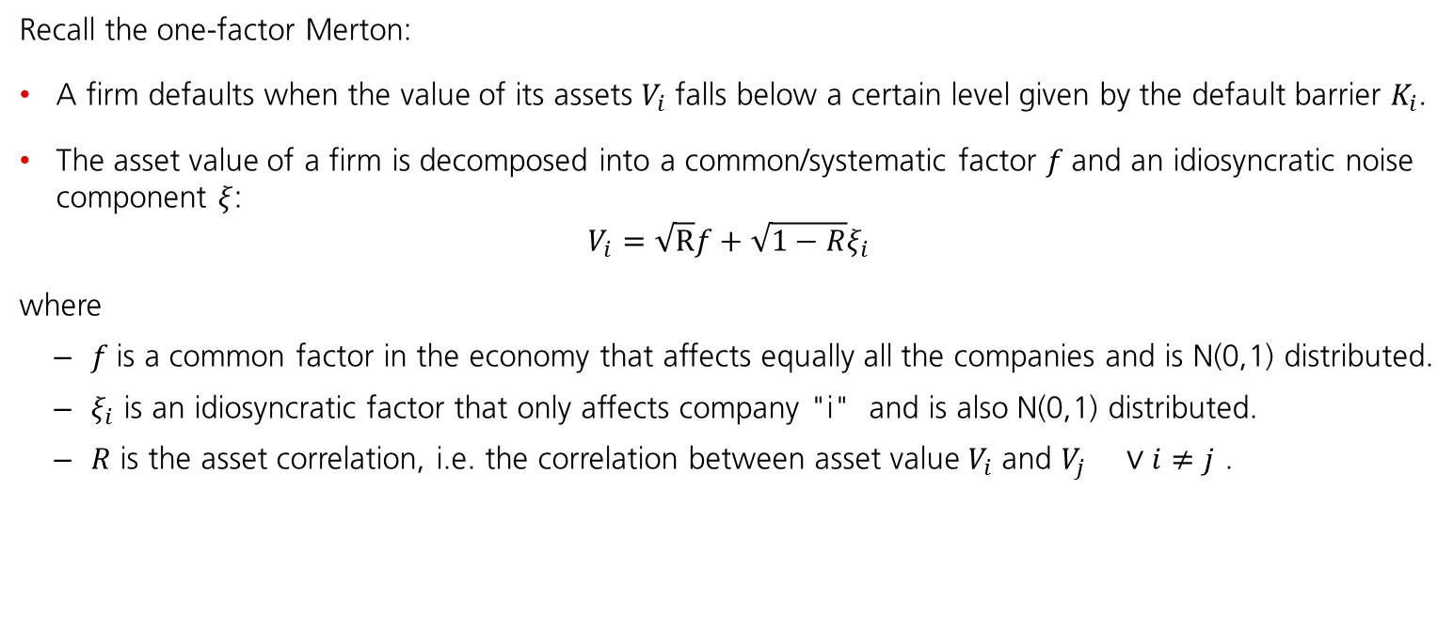
Modelling Assumptions behind RWAs
$$[LGD∗N\left[{\left(1−R\right)}^{−0.5}∗N^{−1}\left(PD\right)+{\left(\frac{R}{1−R}\right)}^{0.5}∗N^{−1}\left(0.999\right)\right]−LGD∗PD] ∗f(PD, M)$$
Where is this coming from? This must be a "kind of" conditional PD…
Recall the one-factor Merton:
A firm defaults when the value of its assets $V_{i}$falls below a certain level given by the default barrier $K_{i}$.
The asset value of a firm is decomposed into a common/systematic factor $f$and an idiosyncratic noise component $ξ$:
$$V_{i}=\sqrt{\text{R}}f+\sqrt{1−R}ξ_{i}$$
where
$f$is a common factor in the economy that affects equally all the companies and is N(0,1) distributed.
$ξ_{i}$ is an idiosyncratic factor that only affects company "i" and is also N(0,1) distributed.
$R$ is the asset correlation, i.e. the correlation between asset value $V_{i}$ and $V_{j } ∨i≠j$ .

Slide 22



Some mathematics of the RWAs formula
In the one factor model, default occurs when $V_{i}≤K_{i}$. If PD is the default probability, then
$$PD_{i}=P\left(V_{i}≤K_{i}\right)=N\left(K_{i}\right)→K_{i}=N^{−1}\left(PD_{i}\right)$$
Therefore an appropriate default threshold $K_{i}$can be determined by applying the inverse of the normal distribution to the average $PD_{i}$.
Conditional on the common factor $f=y$, it can be shown that:
the firms' values $V_{i}$ as well as the defaults are independent,
the conditional probability of default of firm $i$ reads:
$$PD_{i}\left(y\right)≔P\left(V_{i}≤K_{i}|f=y\right)=P\left(\sqrt{\text{R}}f+\sqrt{1−R}ξ_{i}≤K_{i}|f=y\right)$$
$$=N\left({\left(1−R\right)}^{−0.5}∗K_{i}−{\left(\frac{R}{1−R}\right)}^{0.5}∗y\right)$$

Slide 23

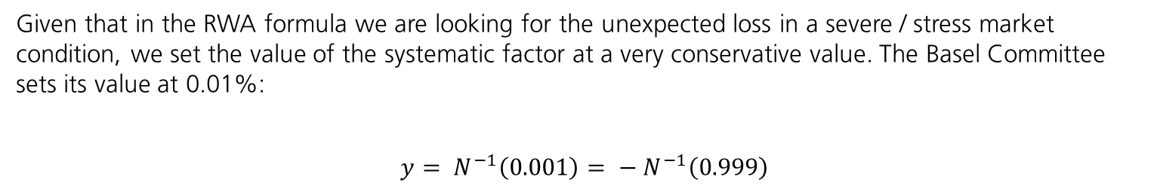
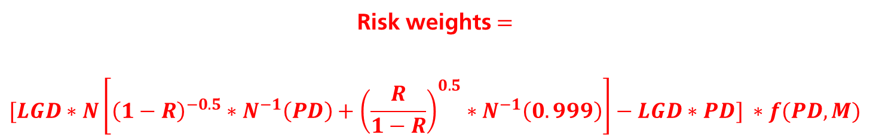
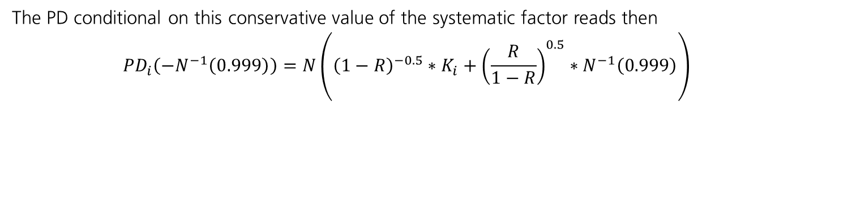
Final derivation of the RWAs formula
Given that in the RWA formula we are looking for the unexpected loss in a severe / stress market condition, we set the value of the systematic factor at a very conservative value. The Basel Committee sets its value at 0.01%:
$$y= N^{−1}\left(0.001\right)= {− N}^{−1}\left(0.999\right)$$
The PD conditional on this conservative value of the systematic factor reads then
$$PD_{i}\left({−N}^{−1}\left(0.999\right)\right)=N\left({\left(1−R\right)}^{−0.5}∗K_{i}+{\left(\frac{R}{1−R}\right)}^{0.5}∗N^{−1}\left(0.999\right)\right)$$
Recalling that $K_{i}=N^{−1}\left(PD_{i}\right)$, we get exactly the last component of the RWAs formula previously discussed:
Risk weights $=$
$$[LGD∗N\left[{\left(1−R\right)}^{−0.5}∗N^{−1}\left(PD\right)+{\left(\frac{R}{1−R}\right)}^{0.5}∗N^{−1}\left(0.999\right)\right]−LGD∗PD] ∗f(PD, M)$$
ü
ü
ü

Slide 24
Section 5
Concluding remarks

Slide 25
Conclusion
One of the most dramatic changes to the banking industry since the last financial crisis is the rollout of new capital requirements for banks.
Regulatory cycles are driven by crises. Banks without regulations would not keep sufficient capitals.
Economic capital is used in efficient capital allocation, whereas regulatory capital is a buffer for unexpected and catastrophic losses.
Calculation of VaR should always go in conjunction with scenario analysis and stress tests.
There are several financial ratios that describe how well-capitalized a Bank is, e.g. the Leverage ratio := Equity / Assets. This concept does not sufficiently reflect the riskiness of the Assets and might give Banks a wrong incentive on how to structure the asset side of their Balance Sheet.
In order to correctly take the risk of the different assets into account, the Basel Committee requires Banks to have a Capital Adequacy Ratio (CAR) := Capital / RWAs above a pre-defined level.
RWAs can be derived based on the One-factor Merton Model (for corporate loans)

Slide 26
Section 7
Q&A

